Slide 1
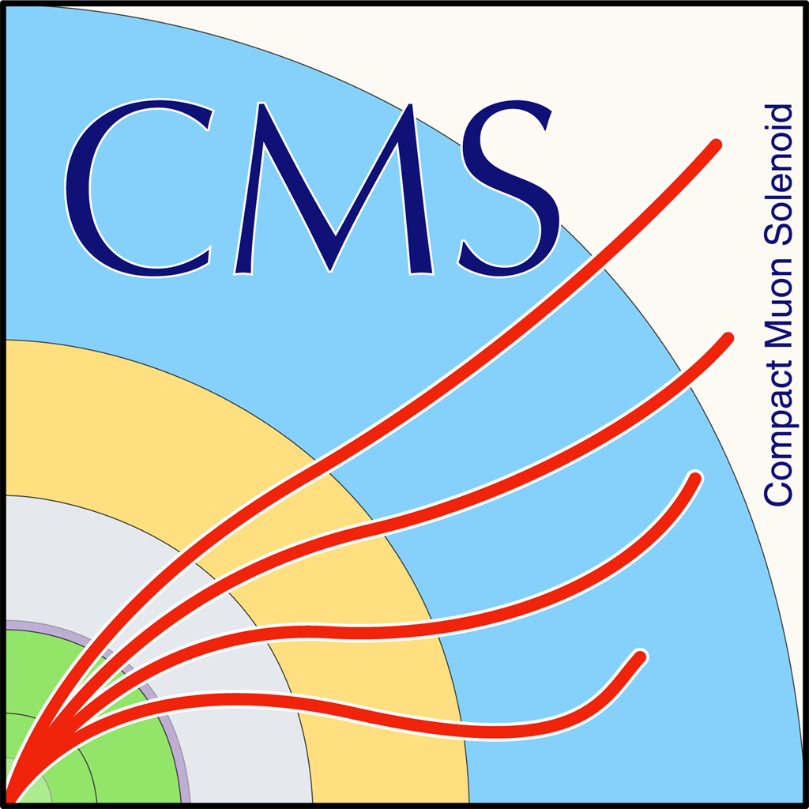

Status Report for ttbar Spin Correlation
George Bakas

Slide 2
Top Spin Correlation
Files are ready (CMSSW 10_2X)
TT_noSC_Mtt-1000toInf_TuneCP5_13TeV-powheg-pythia8
TT_Mtt-1000toInf_TuneCP5_13TeV-powheg-pythia8
Chi2Test for various distributions
|Cos(χ₁)|, χ₁:angle between W’s in ZMF
|Cos(χ₂)|, χ₂:angle between top and W in ZMF
|Δφ| between W’s in parton level
What other distribution could have sensitivity to SC in the all hadronic channel?
If p_value < α (0.05) then we can assume that the hypothesis that the two histograms are identical is rejected
If p_value > α (0.05) then we can assume that the hypothesis that the two histograms are identical can be accepted
Chi2Test Results:
Chi2 = 143.020042, Prob = 2.53302e-16, NDF = 31, igood = 0
Chi2 = 38.513869, Prob = 0.166093, NDF = 31, igood = 0
Chi2 = 48.329603, Prob = 0.0135818, NDF = 29, igood = 0

Slide 3
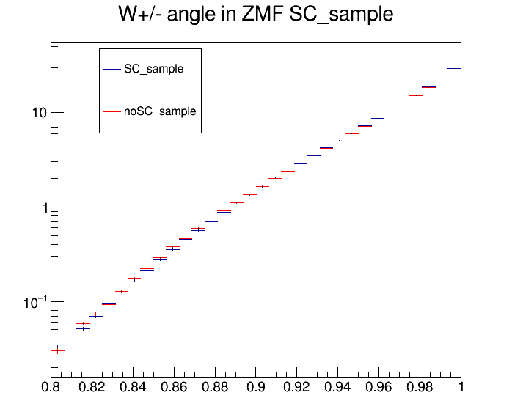
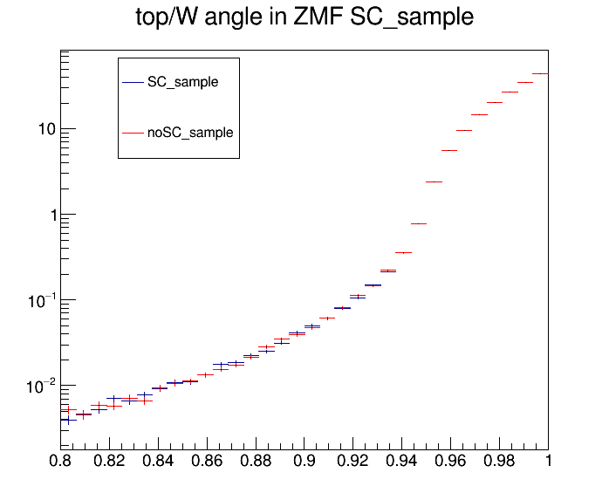
Top Spin Correlation
|cos(χ₁)|
|cos(χ₂)|

Slide 4
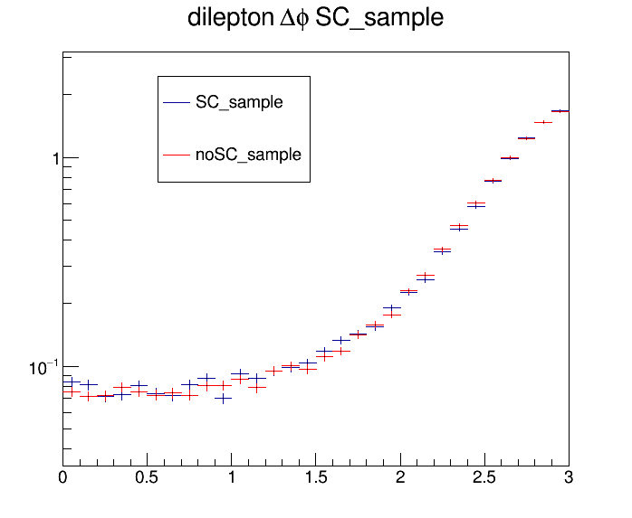
Top Spin Correlation
|Δφ|

